Slide 1
Marine Vessel Predictive Maintenance

Slide 2
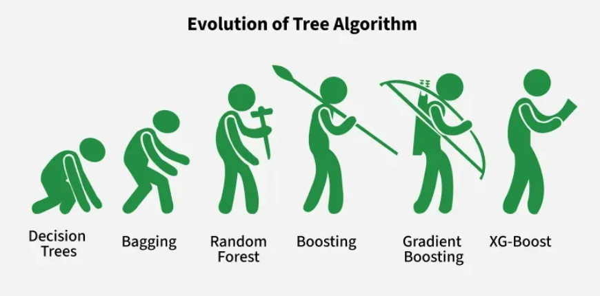
Different Machine learning algorithms
SVM
Supervised machine learning algorithm
Classification and regression tasks
Finds best boundary that separates different classes in the data
Random Forest
Machine learning algorithm that uses decision trees to make better predictions
Each tree looks at different random parts of the data
Results are combined by voting for classification or averaging for regression
XGBoost
Extreme Gradient Boosting
Advanced machine learning algorithm for efficiency, speed and high performance

Slide 3
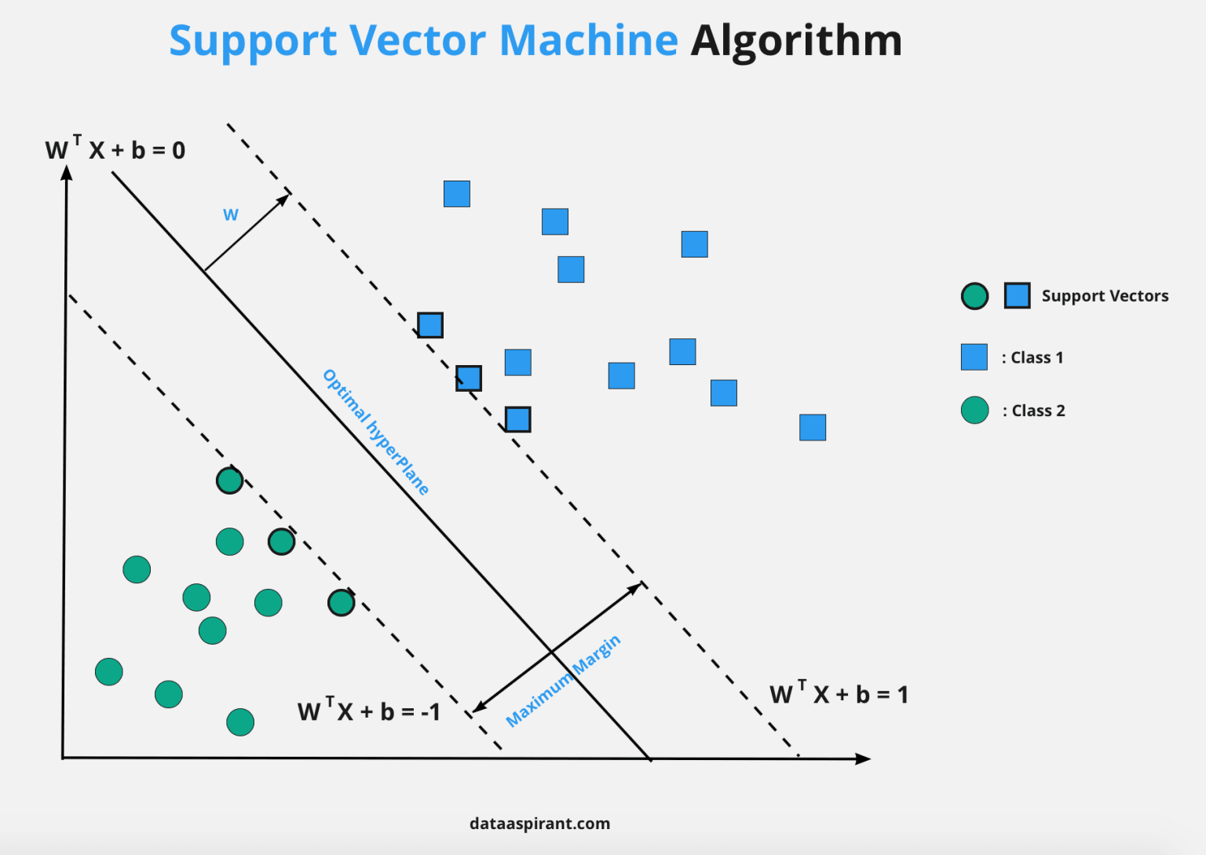
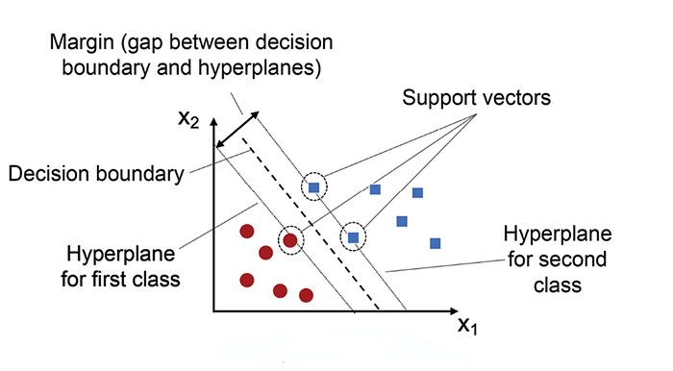
SVM
Supervised machine learning algorithm
Tries to find the best boundary known as hyperplane
Hyperplane: decision boundary separating different classes in feature space
Linear and Non Linear SVM
Used for classification and regression tasks
Disadvantages:
Slow training
Noise sensitivity

Slide 4
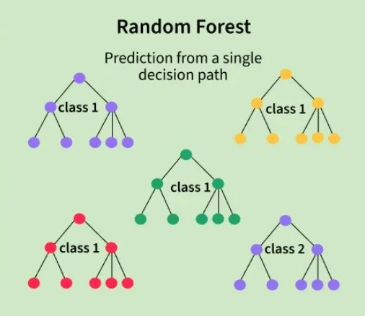
Random Forest
Algorithm that uses many decision trees to make better predictions
Many trees – pick random features – each tree make prediction - combine the predictions – most agreed prediction = Results
Helps overfitting and gives trustworthy total prediction
Disadvantage:
Computationally expensive
Hard to interpret model

Slide 5
XGBoost
Optimized implementation of Gradient Boosting
Ensemble type of algorithm that combines multiple weak models to form a stronger model
Uses decision trees as its base learners and combines them sequentially to improve the models performance
Each new tree is trained to correct the errors made by the previous tree (boosting)
Designed for efficiency, speed and high performance
Just a better Gradient boosting
Disadvantages:
Computationally intensive
Sensetive to noise and outliers

Slide 6
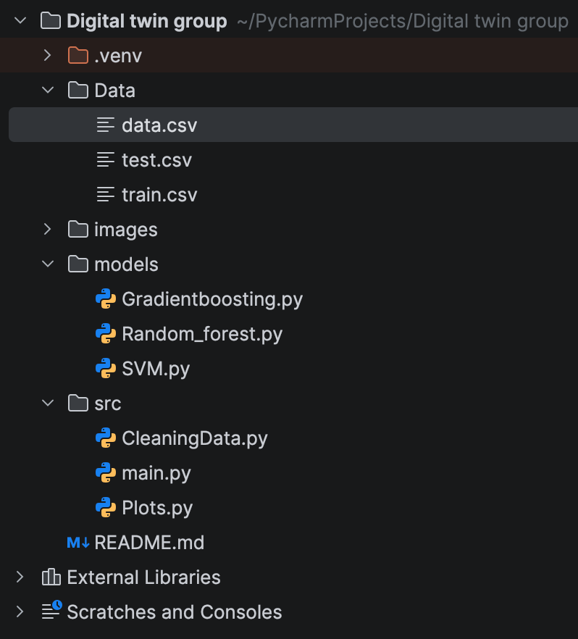
Train and test data
Structure
Train–Test Split
30-70%
Randomization
Consistency

Slide 7
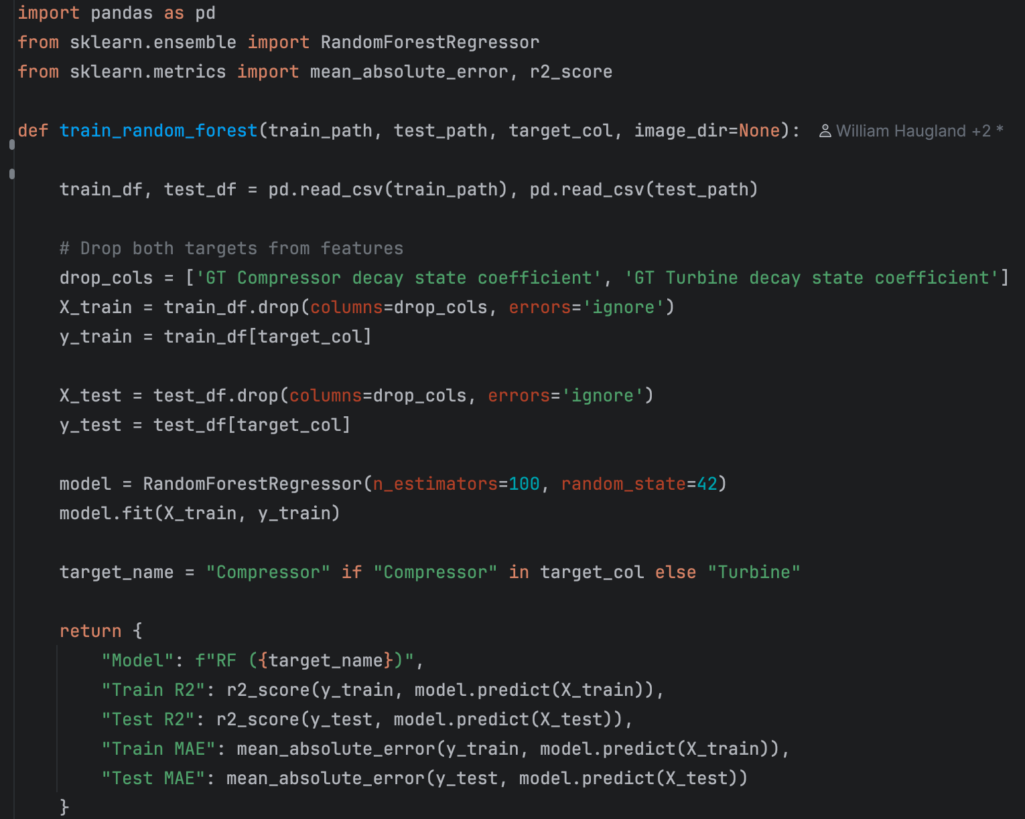
Example code And Packages
from xgboost import XGBRegressor
from sklearn.ensemble
import RandomForestRegressor
from sklearn.svm import SVR
from sklearn.metrics
import mean_absolute_error, r2_score
Notes:
9

Slide 8
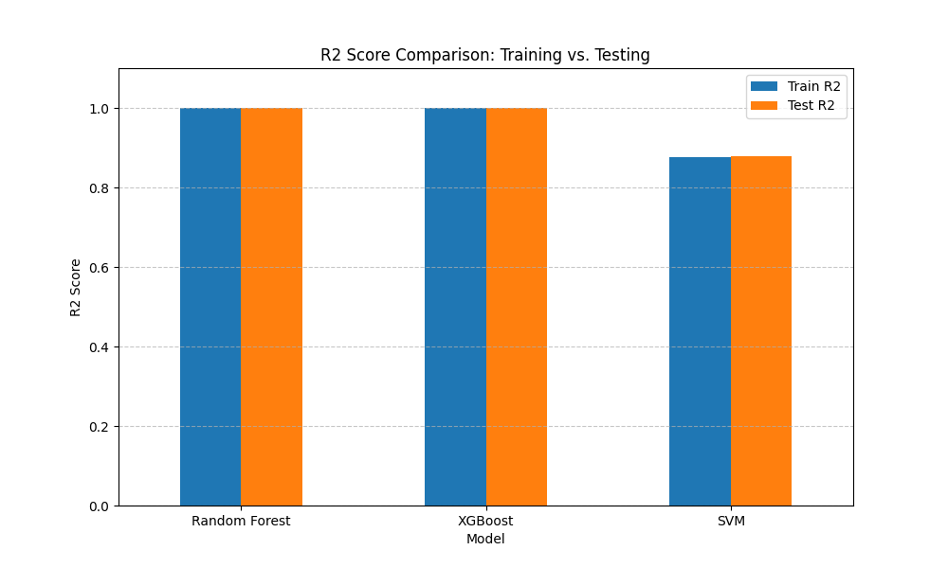
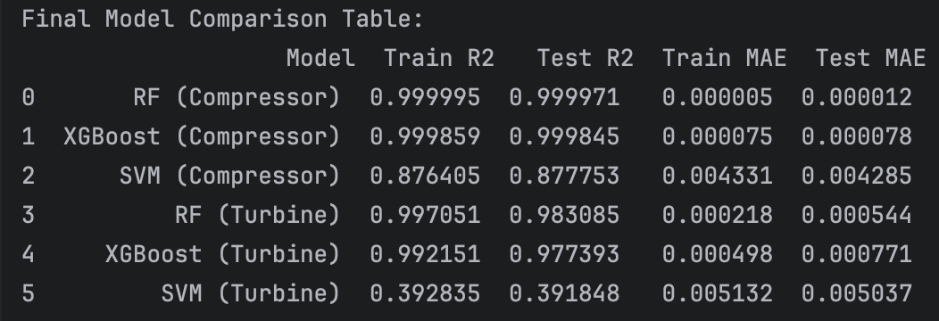
Comparison
Mean Absolute Error (MAE)
Average magnitude of error
Represents the average difference
R-squared
Variance
Gives a value between 0 and 1
Closer to 1, higher accuracy
Notes:
Based on your results, here is an explanation of what the Mean Absolute Error (MAE) and R-squared (R2) values mean for your Digital Twin project's predictive models.
Understanding the Metrics
Mean Absolute Error (MAE): This measures the average magnitude of the errors in a set of predictions. In your case, it represents the average difference between the actual GT Compressor decay state coefficient and what the model predicted.
Interpretation: A lower MAE is better. Since your target values are likely small coefficients, having a very low MAE (like 0.000005) indicates the predictions are extremely close to the actual values.
R-squared (R2): This indicates how much of the variance in the target variable is explained by the model's features.
Interpretation: It ranges from 0 to 1. An R2 of 1.0 would mean the model perfectly explains all the data. An R2 of 0.999 suggests an almost perfect fit to the data.
Model-Specific Breakdown
1. Random Forest (MAE: 0.000005 | R2: 0.999995)
Performance: This is your best-performing model on the training set.
Analysis: An R2 this close to 1.0 and a near-zero MAE suggest that the Random Forest algorithm has effectively "memorized" the patterns in the training data. While this looks excellent, it often indicates overfitting, meaning the model might struggle with new, unseen data.
2. XGBoost (MAE: 0.000075 | R2: 0.999859)
Performance: Extremely high, though slightly less "perfect" than Random Forest.
Analysis: Like Random Forest, XGBoost is a tree-based ensemble method. These results show it is highly capable of capturing the complex relationships between propulsion parameters (like torque and fuel flow) and the compressor's state.
3. SVM (MAE: 0.004331 | R2: 0.876405)
Performance: This is the lowest performing of the three.
Analysis: While an R2 of 0.87 is still considered good in many fields, it shows that the Support Vector Machine is not capturing the data's complexity as well as the tree-based models. This could be because SVMs are more sensitive to how the data is scaled or because the relationship between the features and the decay coefficient is highly non-linear in a way that the RBF kernel struggled to fully map.
Key Takeaway
Because you specifically requested these models be run only on the training data (the 30% set), these numbers represent how well the models fit the data they have already seen.
The near-perfect scores for Random Forest and XGBoost are common during training. To truly see which model is "best," you would eventually need to evaluate them against the 70% testing set (test.csv) to see if they can generalize their predictions to data they haven't encountered before.

Slide 9
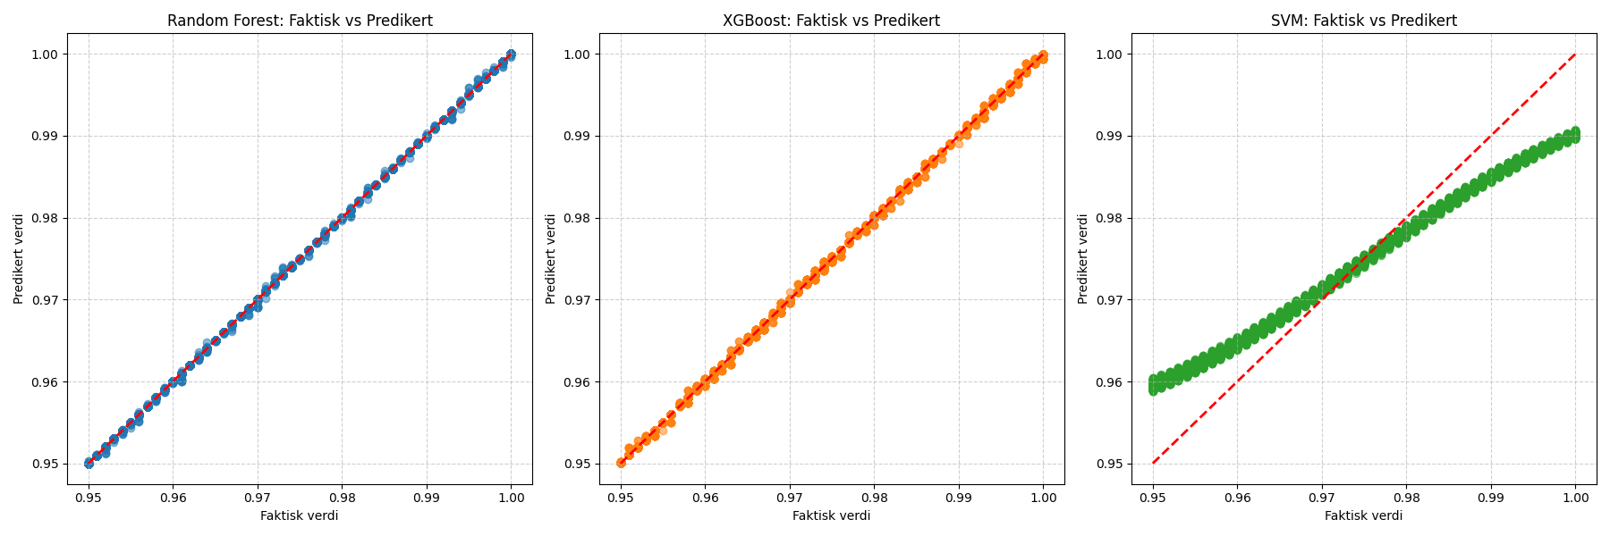
Comparision (Compressor)

Slide 10
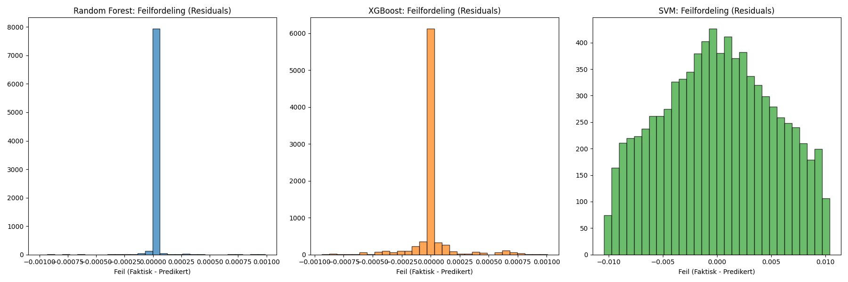
Comparision (Compressor)

Slide 11
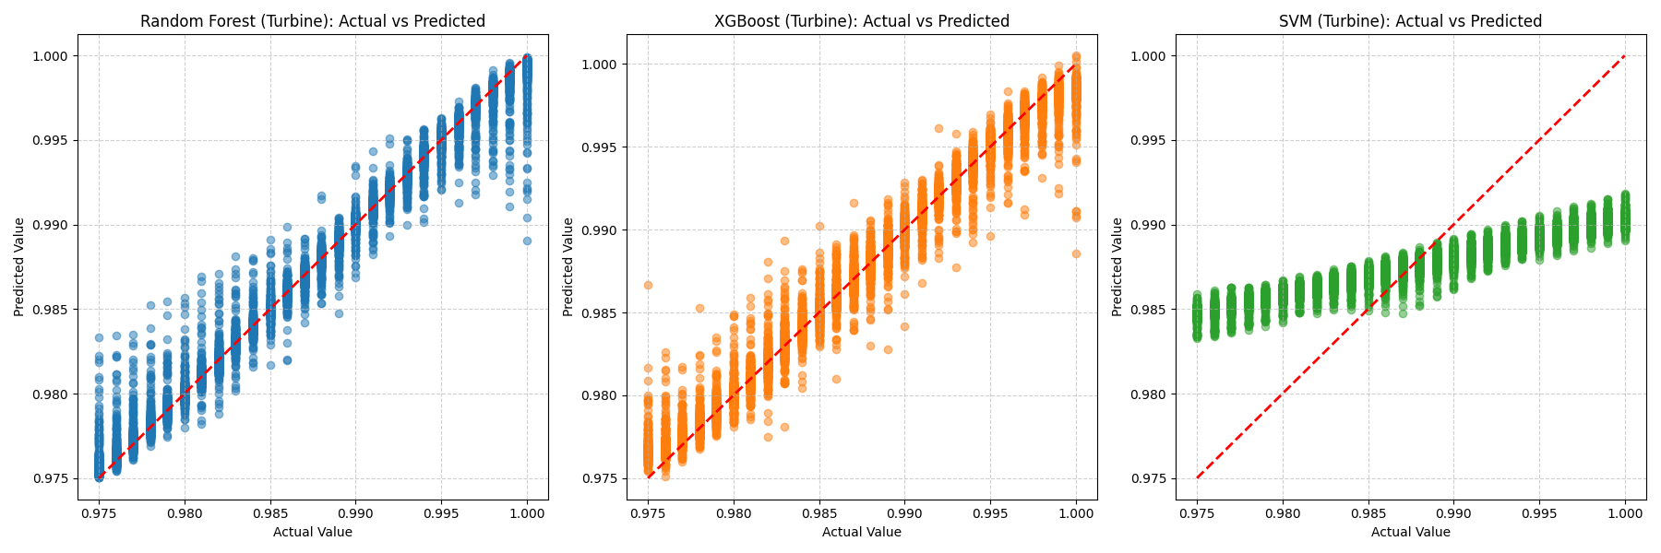
Comparison (Turbine)

Slide 12
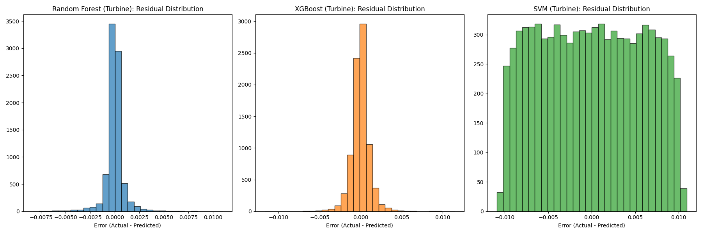
Comparison (Turbine)

